Slide 1
LANDSCAPE ARCHITECT
INTRODUCTION TO DRAWING
INTRODUCTION TO CONSTRUCTION INDUSTRY
ENGLISH I
PREMDYL SHADAN (LEADER)
SARA WEE
OMAR LAYAS
SERAJ ALI
SUE WEN
YANG
SHREYA WILSON

Slide 2
GOOD MORNING AND TIME FOR WORK!
Hello

Slide 3
What is Landscape Architecture?
Landscape architecture is the art and practice of designing the outdoor environment with the blend of natural and built environments

Slide 4
What do they do?
How an outdoor space is used.
Creating a useful outdoor space that is functional and aesthetically-pleasing.
Impact the outdoor space to make it a more interactive space with greater ecological benefit.

Slide 5
The Work Process

Slide 6
Phase 1
Initial Meeting
Site Analysis
Preliminary/ Schematic Design

Slide 7
Initial Meeting
Discuss with client about project
Collect base site information
Discuss about themes, design intents, wants/preferences/requirements and budget

Slide 8
Site Analysis
evaluation of an existing or potential site to identify opportunities and constraints
Development program
Environmental/community/neighbourhood impact
Air flow/ cross-ventilation
Direction of sunlight
Visual/environmental/recreational/vegetation assessment

Slide 9
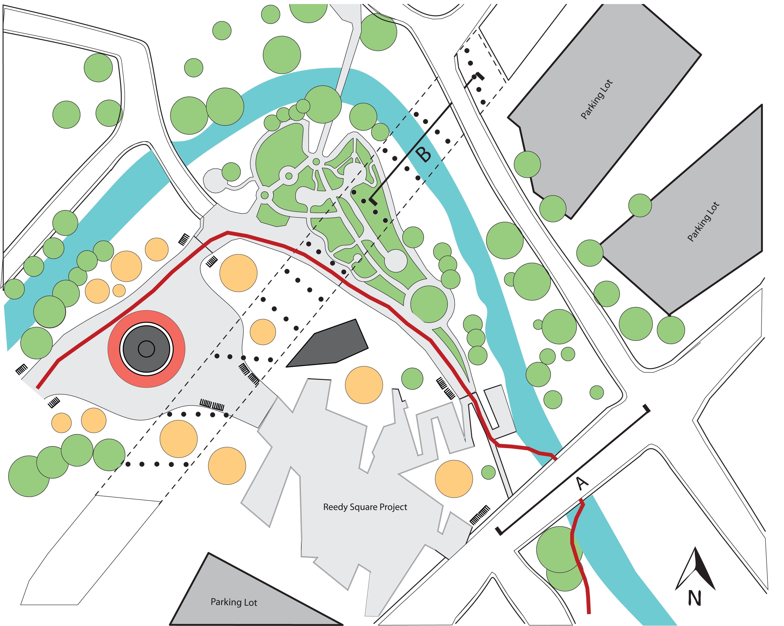
SITE ANALYSIS

Slide 10
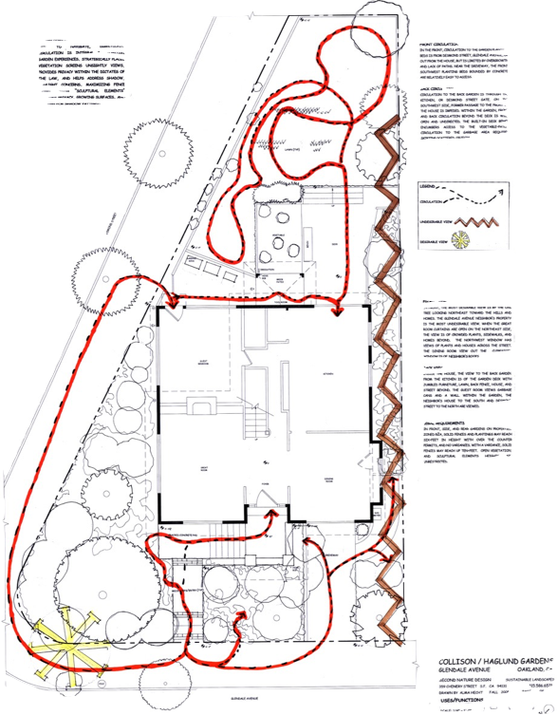
SITE MEASUREMENT DRAWING

Slide 11
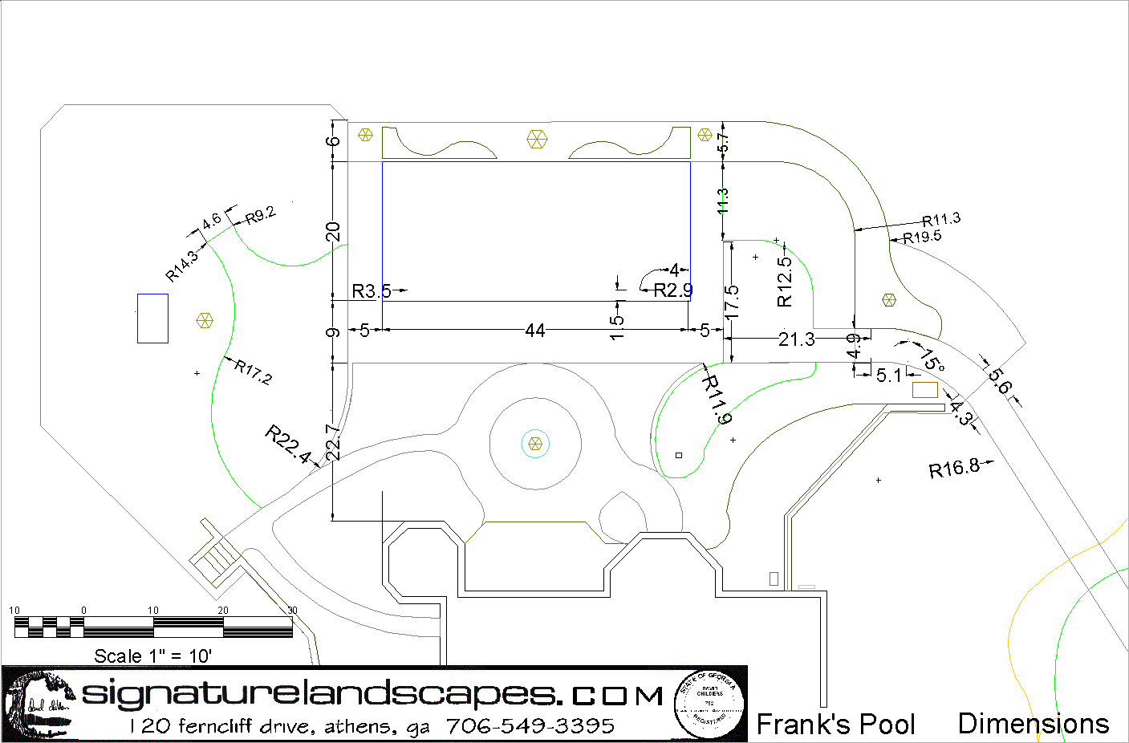

Slide 12
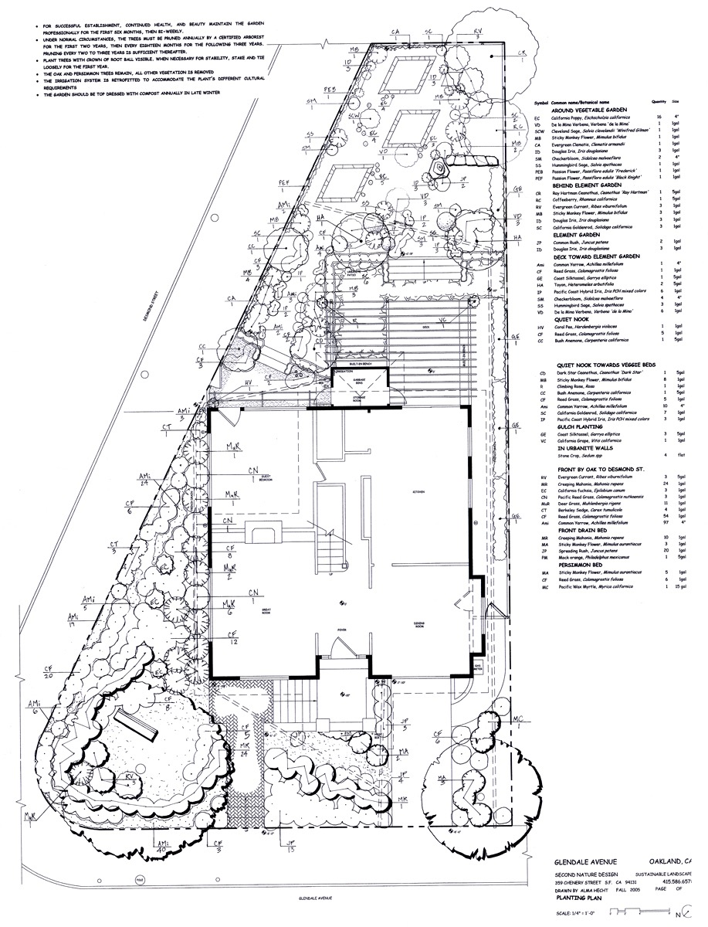

Slide 13
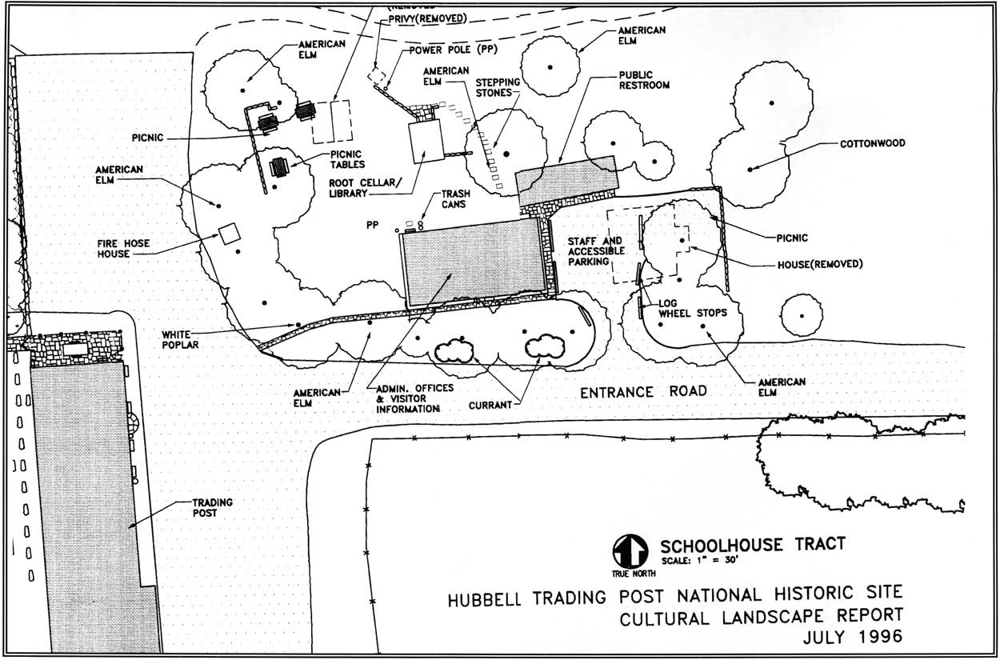
BASE MAP

Slide 14
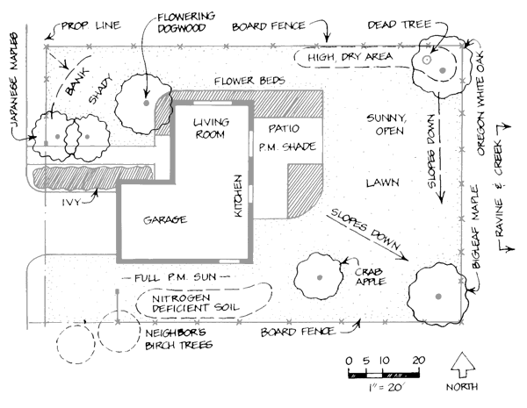

Slide 15
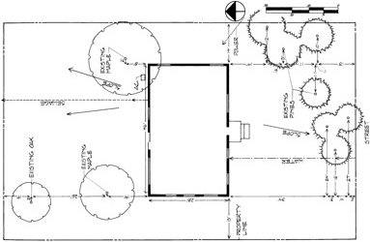

Slide 16
Preliminary/ Schematic Design
(Concept)
Rough sketches
Research & confirmation.
Hardscaping location & layout
Softscaping program
Conceptual level proposal
Photo image examples of proposed elements
CAD (computer-aided design) and video stimulation
Construction materials & techniques suggestions

Slide 17
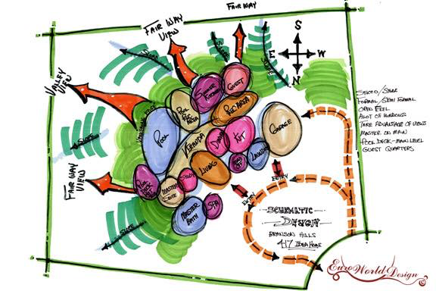
BUBBLE DIAGRAM

Slide 18
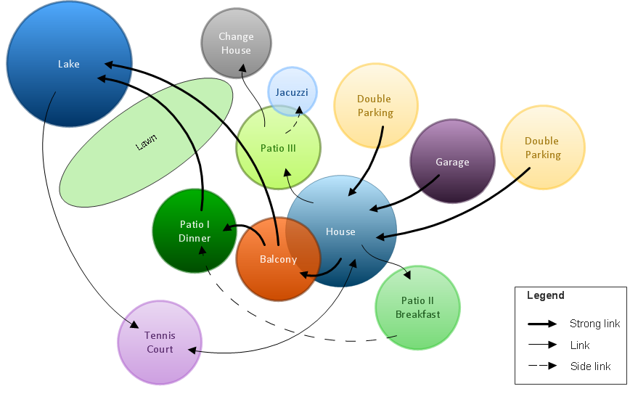

Slide 19
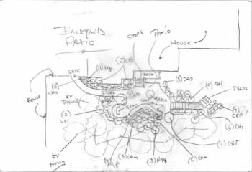
ROUGH SKETCHES

Slide 20
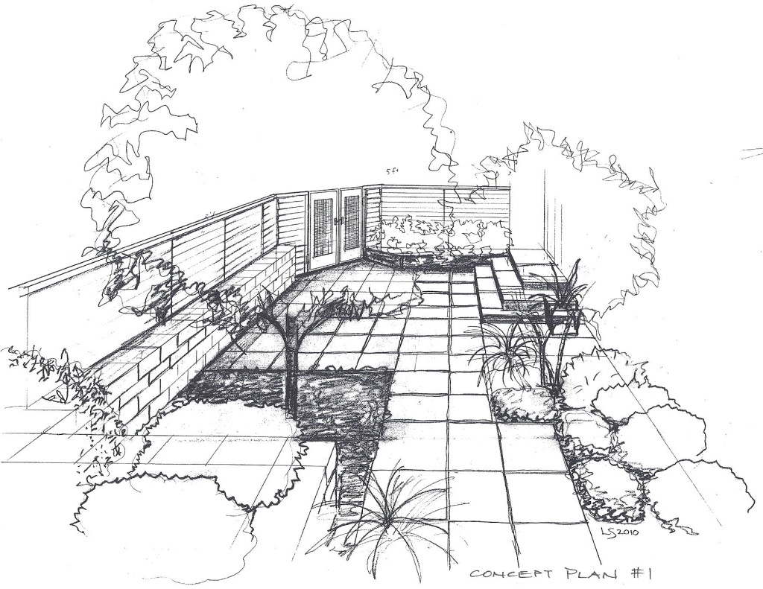

Slide 21
Perspectives/ Rendering

Slide 22
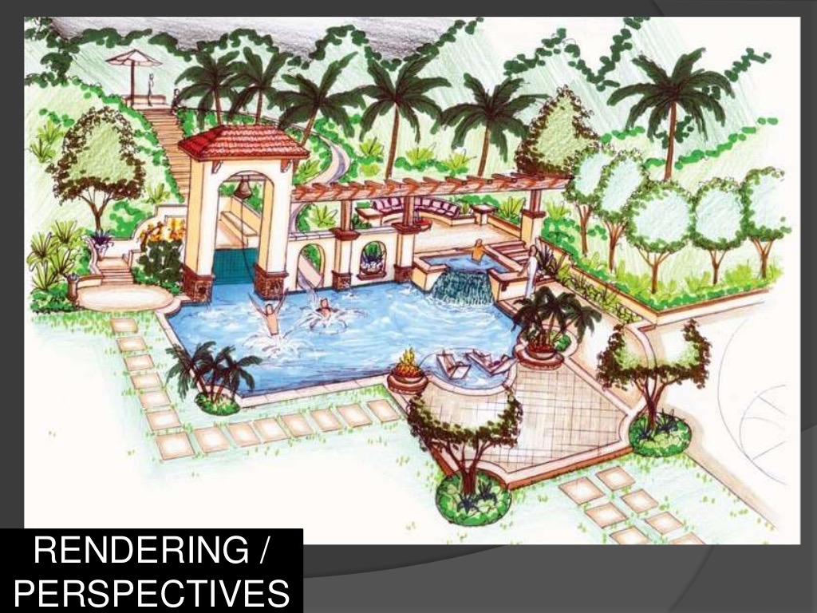

Slide 23
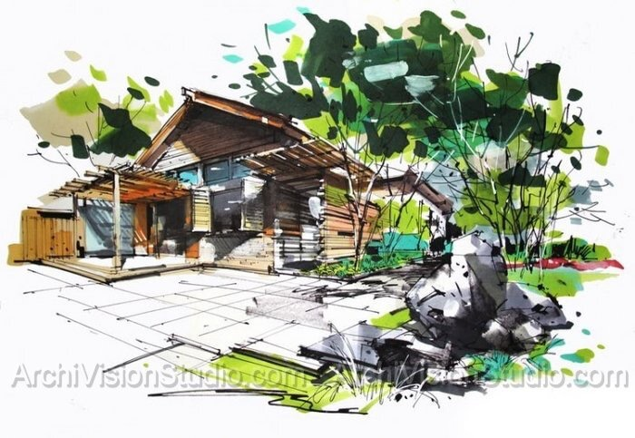

Slide 24
Phase 2
Design Development
Preparation of Construction Documents
Submission for Approval

Slide 25
Design Development
Refining the Design
Proposal of design (detailed drawings and plans, models, photographs, studies, cost estimates)
Changes & revisions (if needed)
Details, working drawings and specifications
Generate Planting Plan (plant lists, sizing, and specifications)
Grading & drainage work
Sections, elevations and details (materials and method of assembly)
Utility requirements.
Required permits and applications
Identify project scope, budget pricing & construction processes

Slide 26
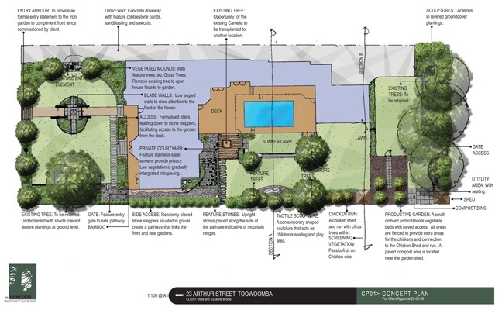
CONCEPTUAL PLAN
(FINAL DESIGN)

Slide 27
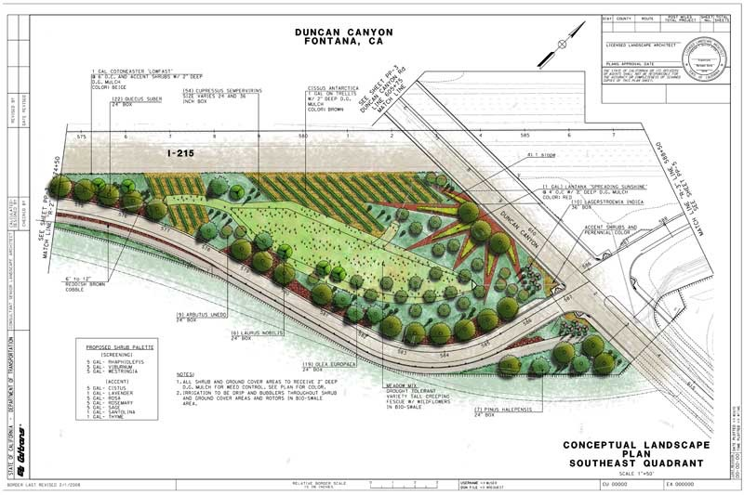

Slide 28
PREPERATION OF CONSTRUCTION DOCUMENTS
Detailed Drawings and Specifications which are used by the Contractor

Slide 29
DETAILED DRAWINGS

Slide 30
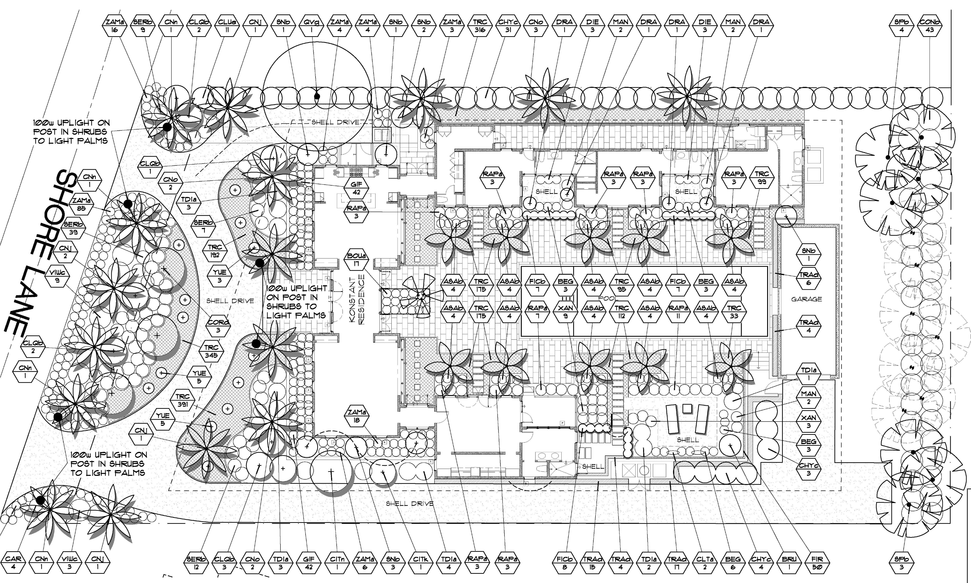
PLANTING PLANS

Slide 31
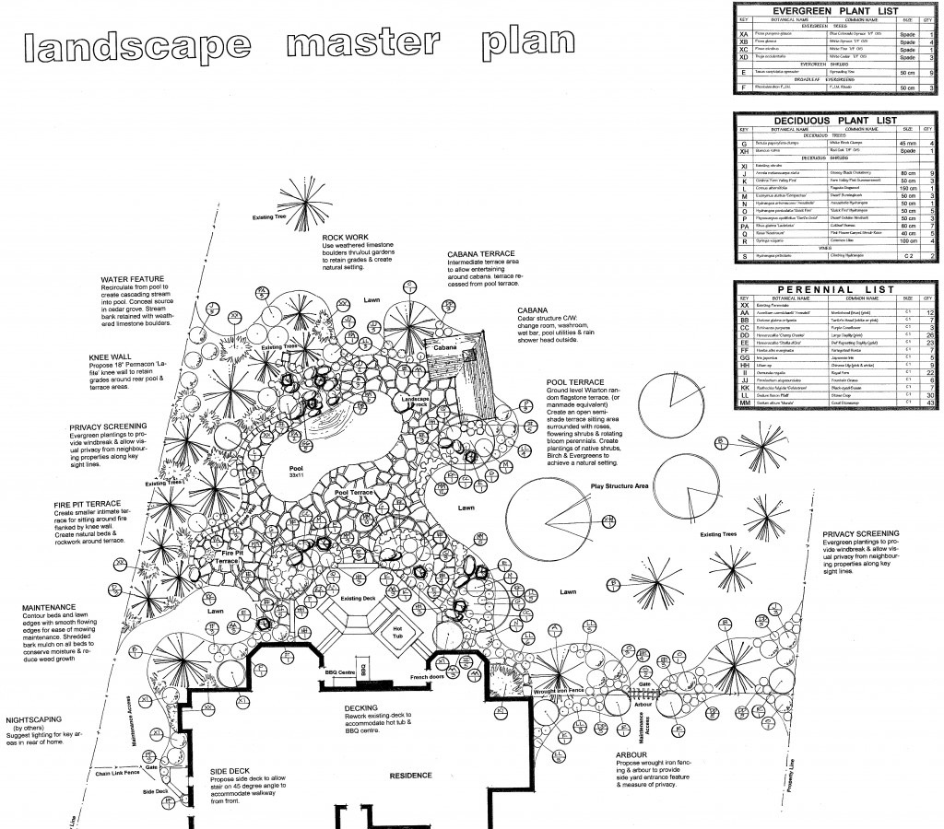

Slide 32
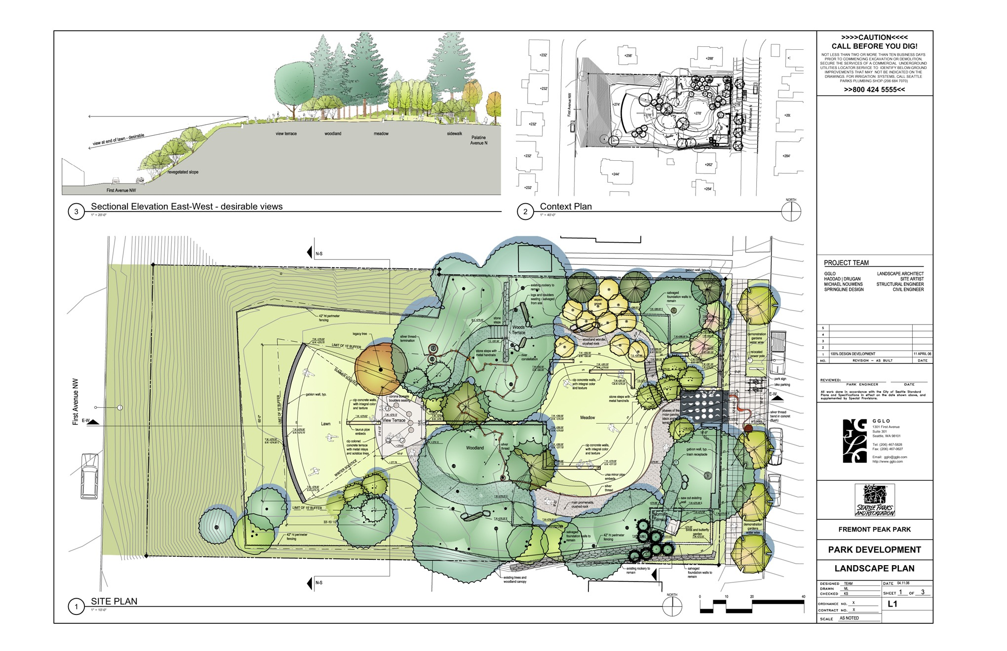

Slide 33
Submission for Approval
Submission of designs to council, government law enforces and regulatory agencies (following all rules & regulations).

Slide 34
Phase 3
Project Management and Inspection

Slide 35
Project Management and Inspection
Provide instructions
Protect owner’s interests (advice and approvals).
Budget/finance quote.
Site visits to review construction process (maintaining quality control, budgets, timing, details, and approve changes)
Final project review and approve payments.
Undertake warrantee review during warrantee period, facilitate and supervise work

Slide 36
THANK YOU

Slide 37
REFERENCES
R.M. Rogan Miller, (2015) (2015 25th February) Homescraper: http://www.homescaper.com
U.A. Unknown Author, (1975), Landscape Architect (2015 3rd March) Landscape Architect : http://www.hr.uci.edu/uc-ser/e/10/aa2-24.html
U.A. Unknown Author, (1995-2010), Job Descriptions, Definitions Roles, Responsibility: Landscape Architects (2015 13th February) Job Descriptions, Definitions Roles, Responsibility: Landscape Architects : http://www.jobbankusa.com/career_employment/landscape_architects/job_descriptions_definitions_roles_responsibility.html
U.A. Unknown Authors (2007), Creativepool (2015 2nd March) Job Description: Landscape Architect : http://creativepool.com/articles/jobdescriptions/landscape-architect-job-description
U.A. Unknown Author (2012), Landscape and Aesthetics Design Manual: Responsibilities of Landscape Architects (2015 17th February) Landscape and Aesthetics Design Manual: Responsibilities of Landscape Architects : http://onlinemanuals.txdot.gov/txdotmanuals/lad/index.htm

Slide 38
REFERENCES
U.A. Unknown Author, (2015), Landscape Architect Job Description, Career as a Landscape Architect, Salary, Employment - Definition and Nature of the Work, Education and Training Requirements, Getting the Job. (2015 9th March) StateUniversity.com : http://careers.stateuniversity.com/pages/292/Landscape-Architect.html#ixzz3Siv29S7T
U.A. Unknown Author (2015), Roles and responsibilities: Landscape architects. (2015 6th March) WA State Licensing: Landscape architect roles, responsibilities, and definitions : http://www.dol.wa.gov/business/designproguidelines/landscaperoles.html
U.A. Unknown Author (2015), Landscape architecture: a guide for clients - the landscape architect's role (2015 22nd February) Landscape Institute : http://www.landscapeinstitute.org/registeredpractices/clientsguide_role.php
U.A. Unknown Author, (2015), Landscape Architectural Designer Responsibilities and Duties (2015 20th February) List of Landscape Architectural Designer Responsibilities and Duties : http://www.greatsampleresume.com/Job-Responsibilities/Landscape-Architectural-Designer-Responsibilities.html

