Slide 1
TAYLOR’S UNIVERSITY CONSTRUCTED LANDSCAPE MS :- IFFA NAYAN PROJECT :- URBAN PARK GROUP MEMBERS :NOTORIOUS TEAM)SERAJEDDIN /FARAH/ FAREEZ/AREEB/SHAMIL)

Slide 2
URBAN PARK
Medium size site located in urban areas
Close to major transport interchanges
Active activity centre for urban residents
5.0 km – 10.0 km form residents areas
Size area within 40 hec – 100 hec
Population size of 50,000 and above

Slide 3
MAP OF TASIK TITIWANGSA

Slide 5
Elements in Tasik Titiwangsa
Tress
Animals
Flowers
Water
Big and small rock

Slide 6
Historical background
Taman tasik tasik titiwangsa was first build in 1975.
It was opened on 1st feb 1980 by Tun Hussein Onn.
It is located at Jalan Kuantan in a recreation area located in the northeast of Kuala Lumpur.
The park was designed by Canary Design Group.

Slide 7
CHARACTERISTICS

Slide 8
Size of tasik titiwangsa
Approximately is
43.13 hectares / 144 acres

Slide 9
Features
Huge lake water fountain
Playground
Tennis court
Public Toilet
Runnig Track
Radio Control Car
Floating Restaurant
Workout Station

Slide 10
Context study
National art gallery
National library
Sutra Dance Library

Slide 11
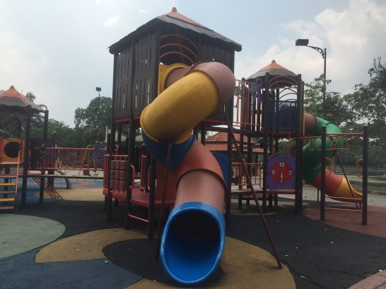
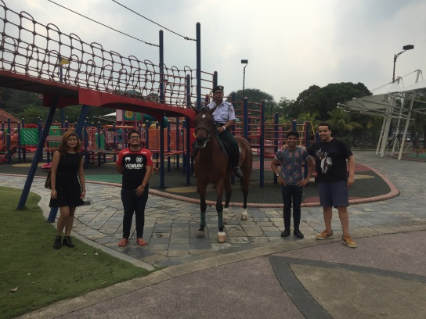
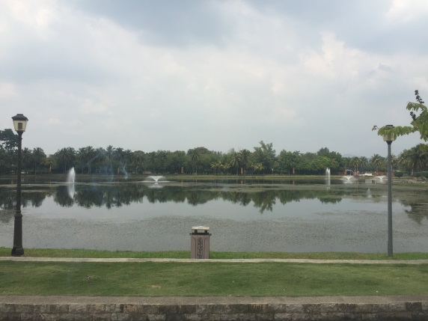
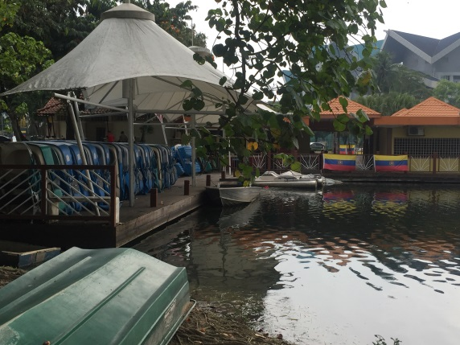
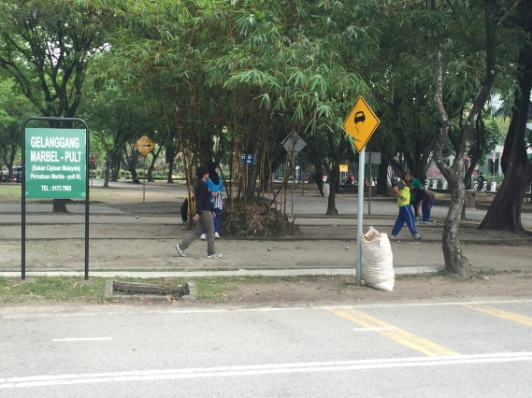
Activities
Work out stations
playground
Horse riding
jogging
Boat paddling
marble pult

Slide 12
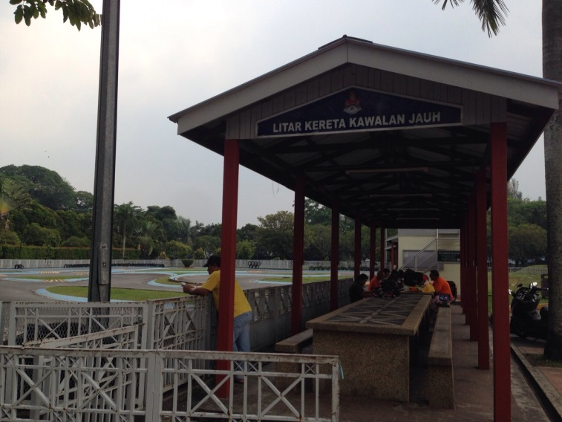
cycling
Radio control car racing

Slide 13
CONCLUSION
Q:- Why do we need an urban park?
To conserve a variety of living things
To make healthy enviroment
To be healthy and enjoy
To learn about the animals and plants in the park

Slide 14
Yoyogi Park.
Japan.

Slide 15
Facts of Yoyogi Park
❀Location: Shibuya, Tokyo, Japan.
❀Size Area: 54.1 hectre.
❀It’s the fourth largest urban park in Tokyo.

Slide 16
HISTORICAL BACKGROUND.
❀1910- It was once a military parade ground.
❀1964- It’s used for Tokyo Olympics. Olympic Village was sited here. Yoyogi National Gymsanium was also sited here.
❀1967- Gymnasium turned into Yoyogi Park.

Slide 17
Characteristics of Yoyogi Park:
❀It has wide lawns, ponds, water fountains and forested areas.
❀Filled with Cherry Blossom trees.
❀The park is open 24 hours, and includes a parking lot.
❀You'll find Meiji Shrine and the National Gymnasium nearby

Slide 20
It is separated by a road into two sections: the forest park A section and the contrasting B section with stadium, outdoor stage, and other facilities.

Slide 21
Things you can do in Yoyogi Park

Slide 22
Jogging.

Slide 23
Cycling.

Slide 24
Relaxing.

Slide 25
Perfect place for dating.

Slide 26
Picnic

Slide 27
Dance in the park.

Slide 28
Watch music performance.

